Slide 1

PERFORMANCE OPTIMIZATION
Taiob Ali

Slide 2

Everything Is Slow!
Any
Code Change or New Deployment?
https://www.business2community.com/strategy/means-business-0722156

Slide 3
Everything Is Slow!
Is Your Cloud Storage Slow?
https://www.business2community.com/strategy/means-business-0722156

Slide 4
Everything Is Slow!
How about Network?
https://www.business2community.com/strategy/means-business-0722156

Slide 5


Everything Is Slow!
It must be database!
http://horizonmindcare.com/Facilities/Academic
https://pngtree.com/freepng/green-yes-tag-vector-material_2870721.html

Slide 6
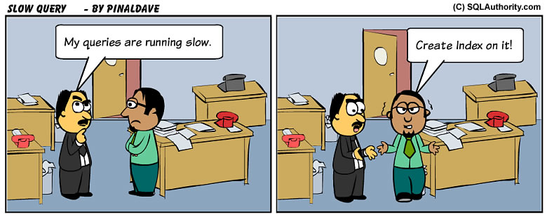

Slide 7

Tools
https://www.dynamixsolutions.com/the-pros-and-cons-of-cloud-vs-on-premise-servers/

Slide 8
Tuning Option
Traditional
DMV
Azure Basic
Overview
Performance Insight
Azure Advanced
Intelligent Insights-Azure SQL Analytics
Extended Events
Query Store
Performance Recommendation
Automatic Tuning

Slide 9
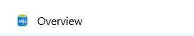

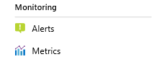
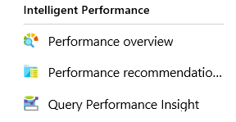

Automatic Tuning
Azure SQL Analytics

Slide 10
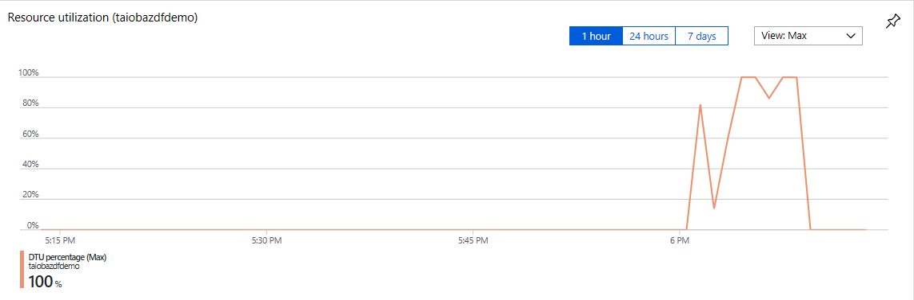
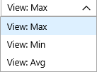
Overview
Notes:
DTU Model

Slide 11
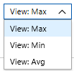
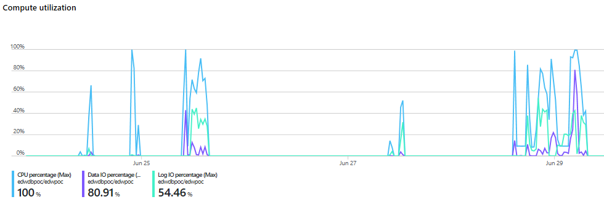
Overview
Notes:
V-Core based purchasing option
You can see the resource in Max, Min, Avg

Slide 12
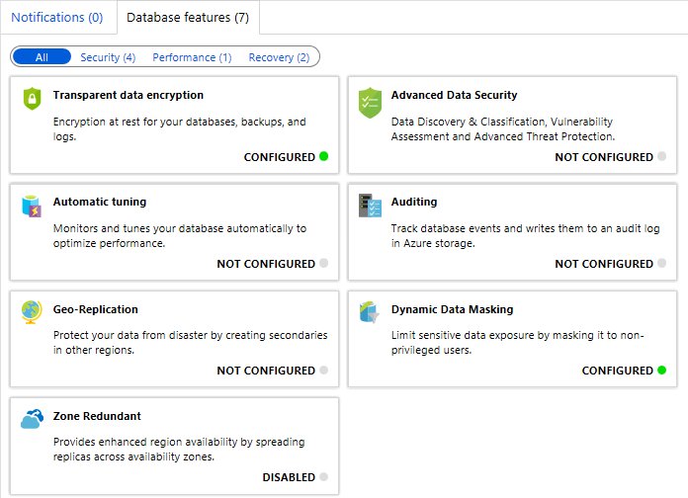
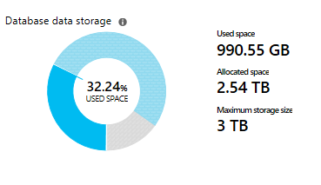
Overview

Slide 13
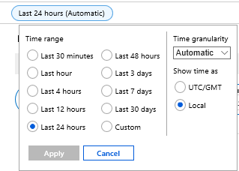
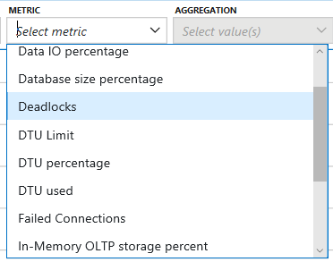
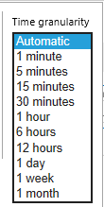
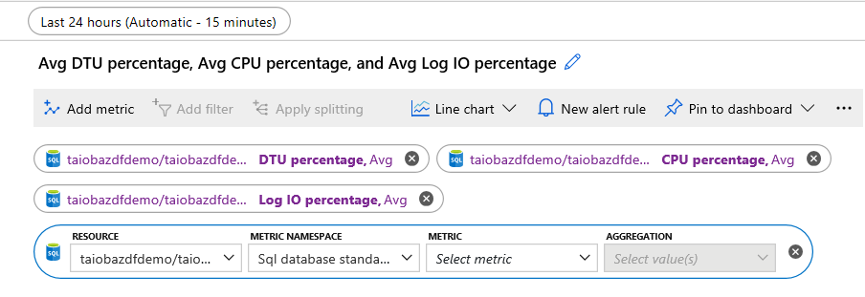
Metrics
1
2
3

Slide 14
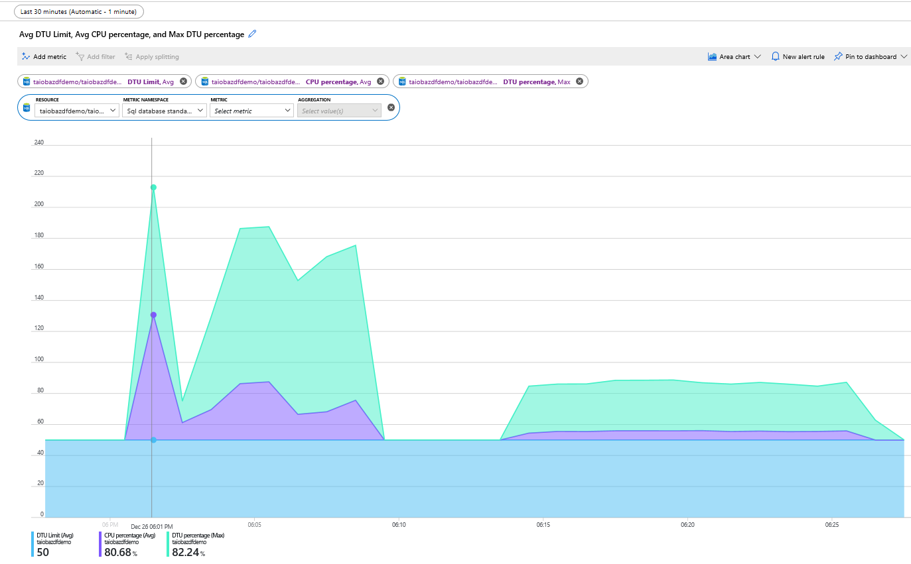
Metrics

Slide 15
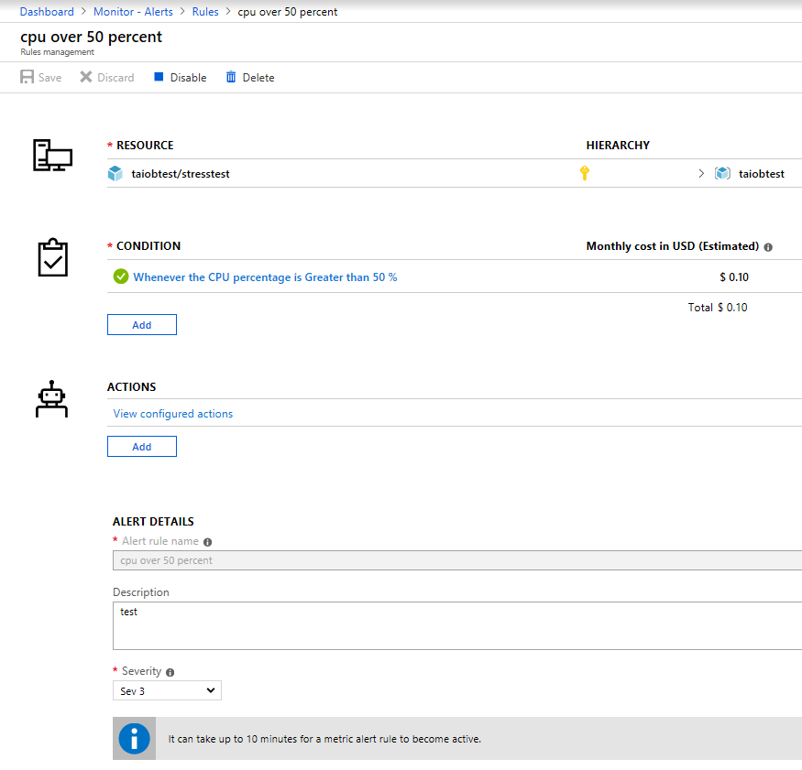
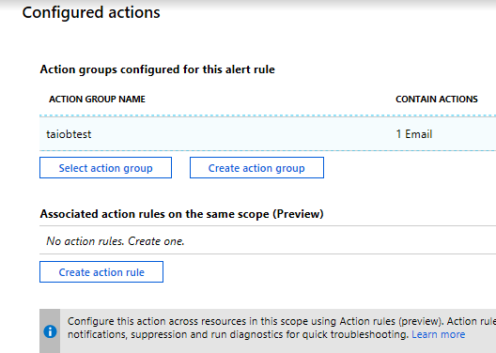
Alert

Slide 16
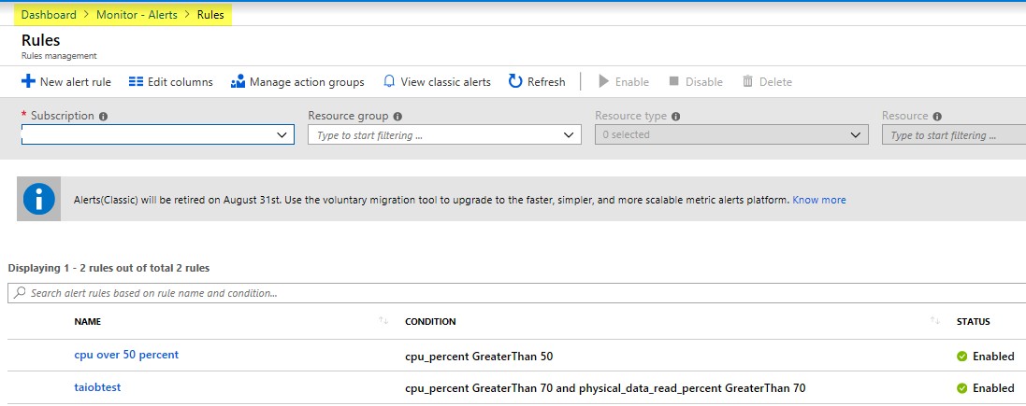
Alert

Slide 17
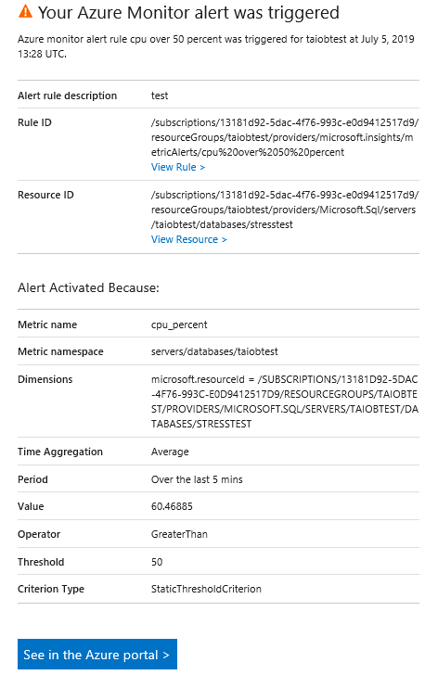

Slide 18

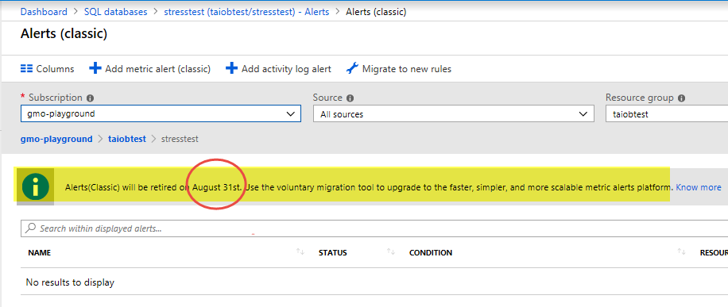
Alert

Slide 19

Automatic Tuning
Azure SQL Analytics

Slide 20
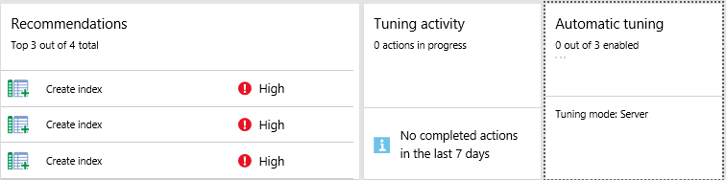
Performance Overview

Slide 21
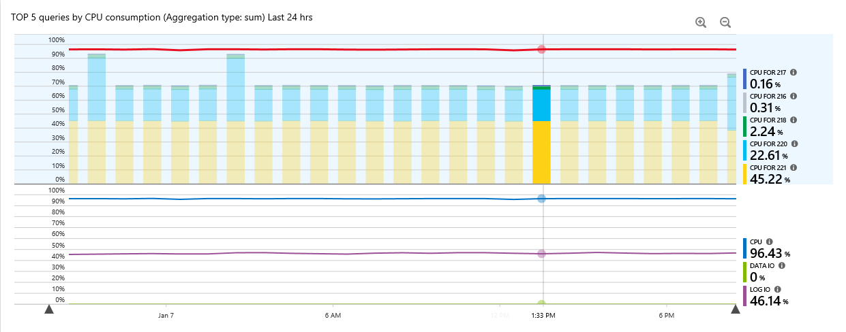
Performance Overview

Slide 22
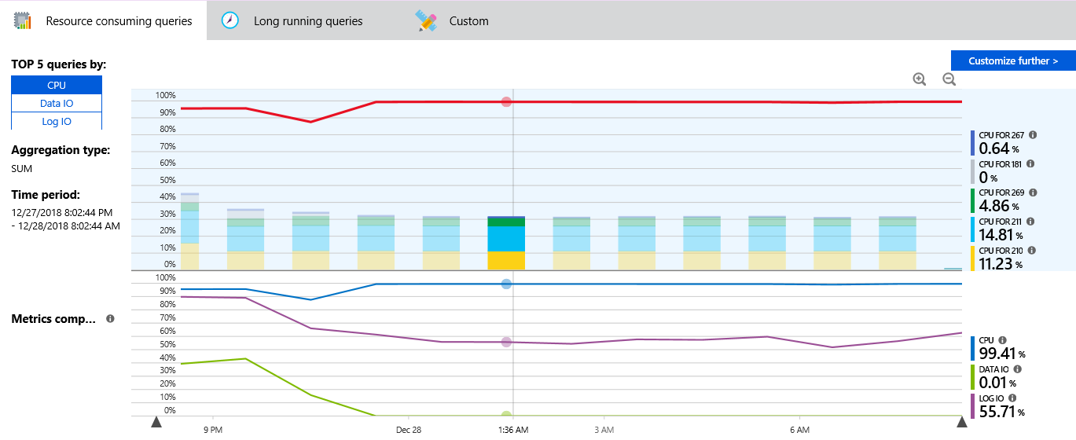
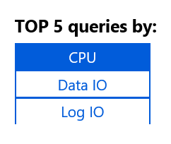
Query Performance Insight

Slide 23
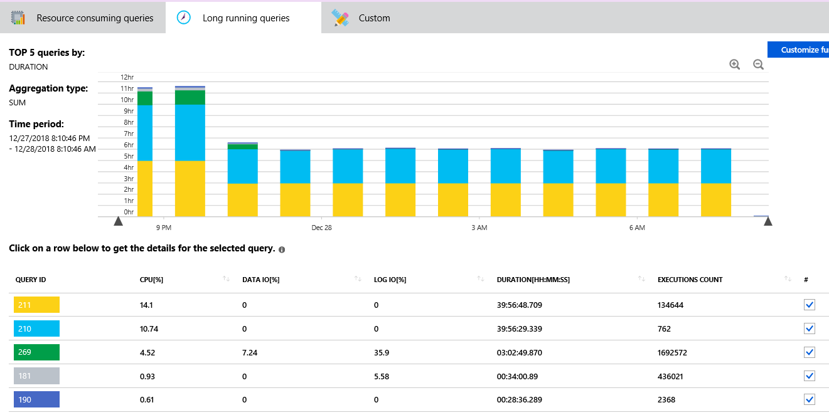
Query Performance Insight

Slide 24
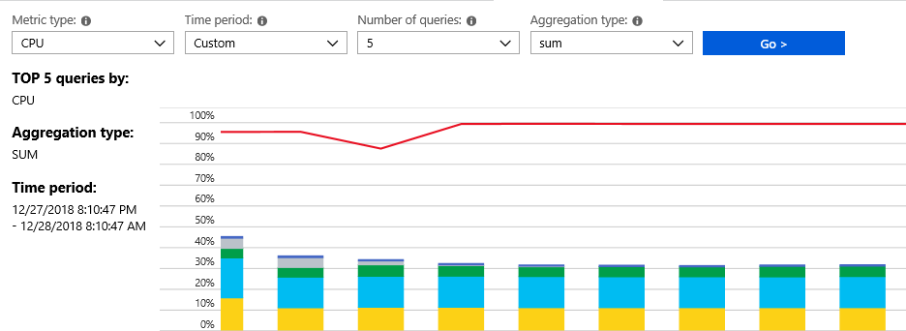
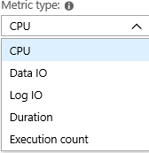
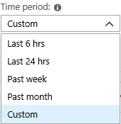
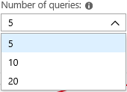
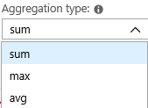
Query Performance Insight

Slide 25
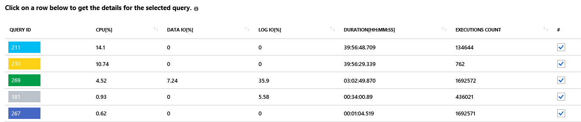

Top 5 Query

Slide 26
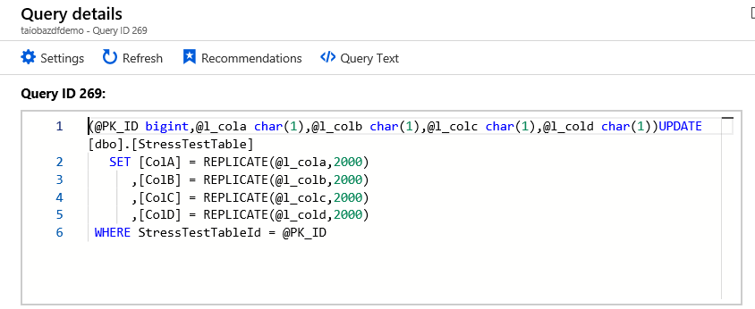
Single Query Details

Slide 27
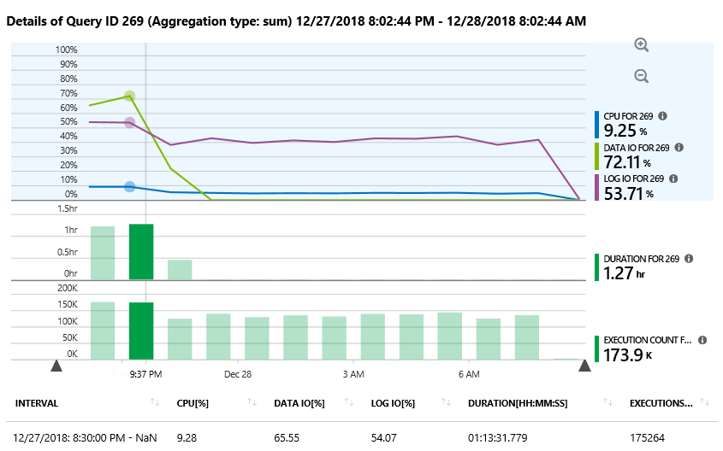
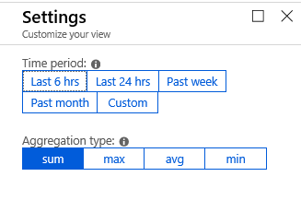
Single Query Details

Slide 28
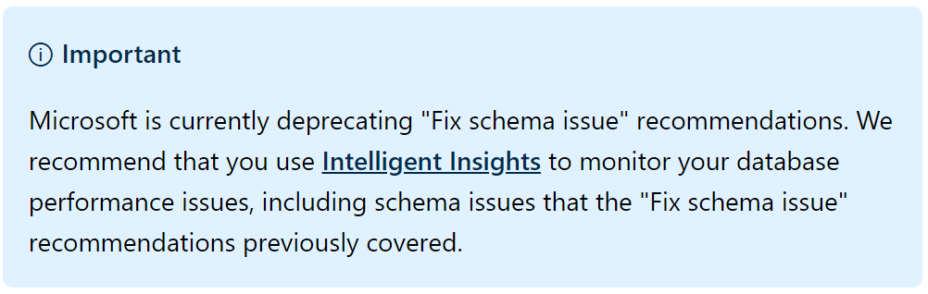
Performance Recommendation
Create index
Drop index
Parameterize queries
Fix schema issues (preview)
Notes:
Drop Index
The index is a duplicate of another index (same indexed and included column, partition schema, and filters).
The index hasn't been used for a prolonged period (93 days).

Slide 29
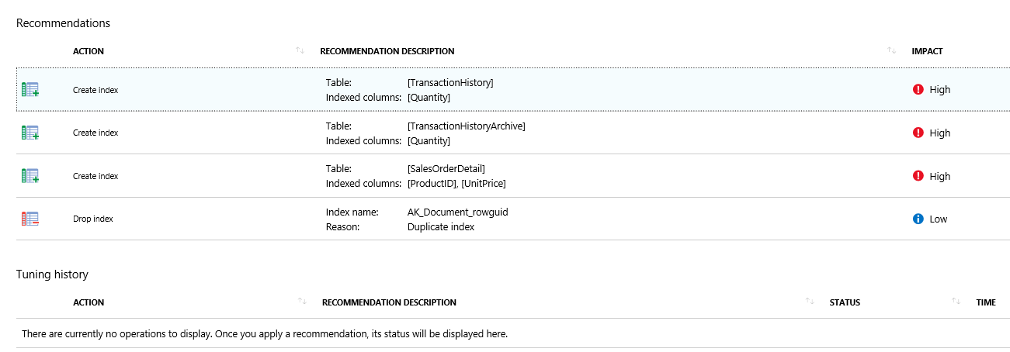
Performance Recommendation

Slide 30
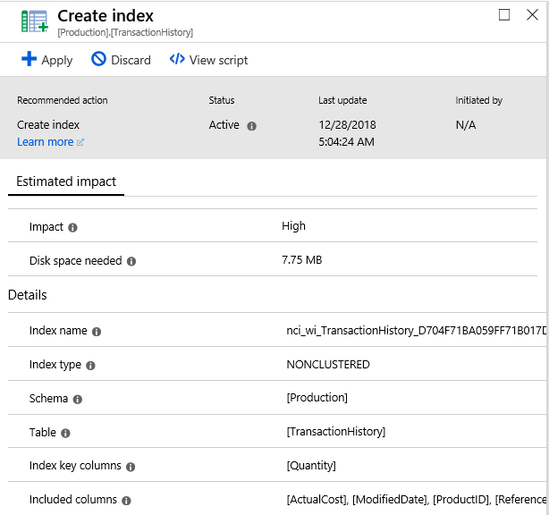
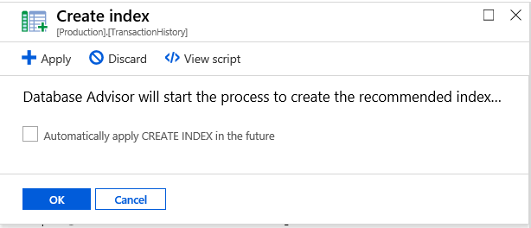
Notes:
You can apply/discard/view script

Slide 31
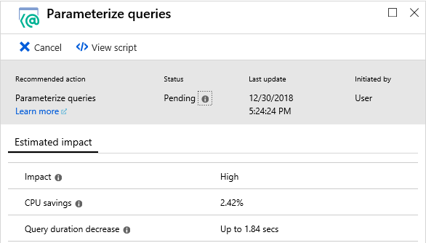
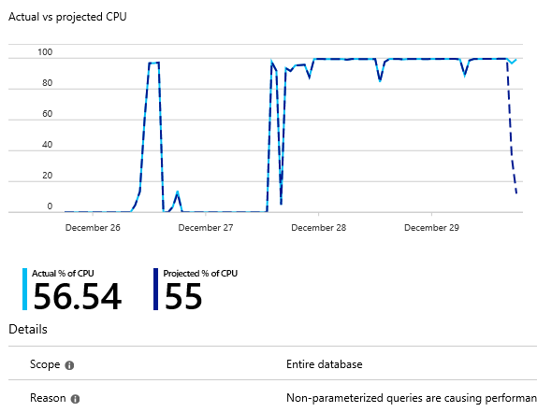
Notes:
How does the parameter queries recommendation looks like
After you apply this recommendation, it enables forced parameterization within minutes on your database. It starts the monitoring process, which lasts for approximately 24 hours. After this period, you can see the validation report. This report shows the CPU usage of your database 24 hours before and after the recommendation has been applied. SQL Database Advisor has a safety mechanism that automatically reverts the applied recommendation if performance regression has been detected.

Slide 32
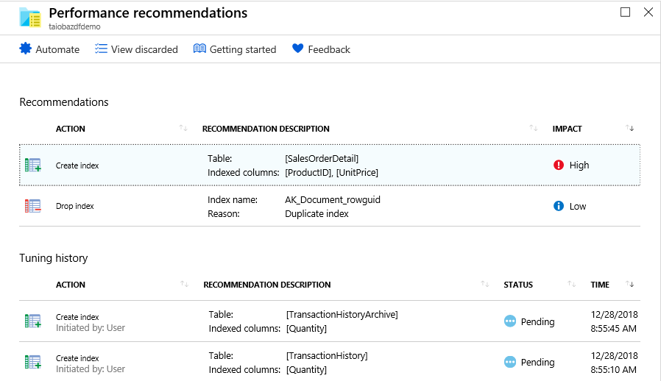
Deployment Status
Notes:
Impact
High
Low
Status
Pending

Slide 33
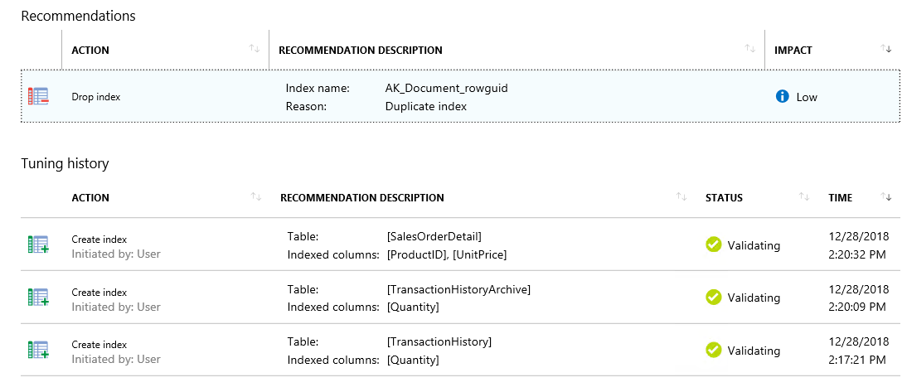
Deployment Status
Notes:
Validating
Looking at impact

Slide 34
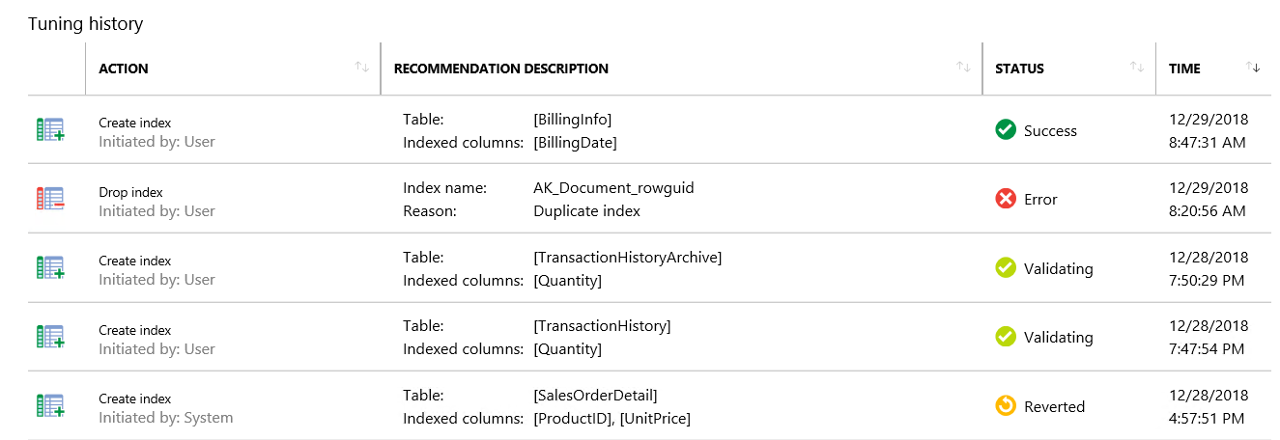
Deployment Status
If the index didn’t improve performance, it's automatically reverted
Notes:
Error-Already been applied manually
Possibilities of reverting recommendation

Slide 35
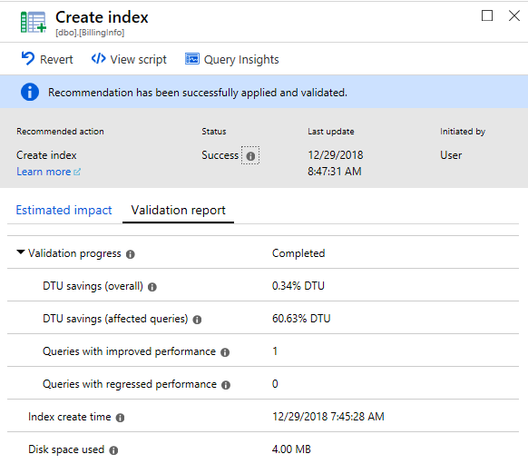
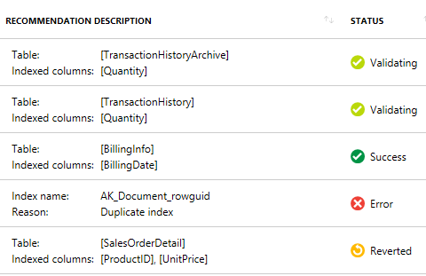
Validation Report
Notes:
Validation also show the impact

Slide 36
Automatic Tuning
Azure SQL Analytics

Slide 37
What Can Automatic Tuning do For You?
Performance Tuning
Verification
Rollback and Self-Correction
History
Scale out
Positive Impact on DevOps
Lower Cost
Notes:
CREATE INDEX - identifies indexes that may improve performance of your workload, creates indexes, and automatically verifies that performance of queries has improved.
DROP INDEX -
The index is a duplicate of another index (same indexed and included column, partition schema, and filters).
The index hasn't been used for a prolonged period (93 days).
FORCE LAST GOOD PLAN - that is slower than the previous good plan
using the last known good plan instead of the regressed plan.

Slide 38
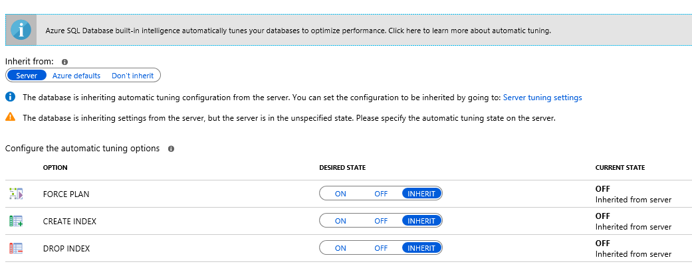
Automatic Tuning
Notes:
Can be independently enabled or disabled per database,
or they can be configured on logical servers and applied on every database that inherits settings from the server.
Logical servers can inherit Azure defaults for Automatic tuning settings.
FORCE_LAST_GOOD_PLAN is enabled,
CREATE_INDEX is enabled, and
DROP_INDEX is disabled.

Slide 39
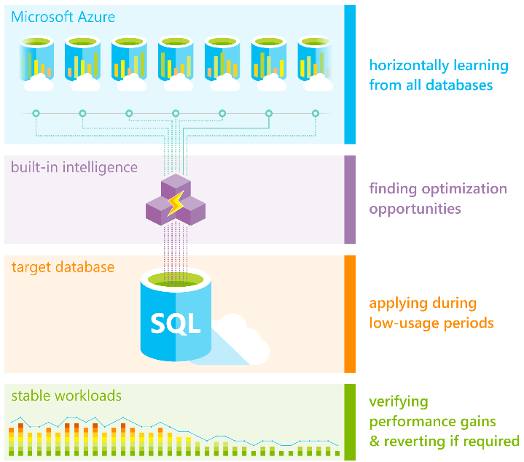
If CPU, Data IO, or Log IO is higher than 80% in the previous 30 minutes, the create index recommendation is postponed. If the available storage will be below 10% after the index is created, the recommendation goes into an error state. If, after a couple of days, automatic tuning still believes that the index would be beneficial, the process starts again.
https://docs.microsoft.com/en-us/azure/sql-database/sql-database-automatic-tuning

Slide 40
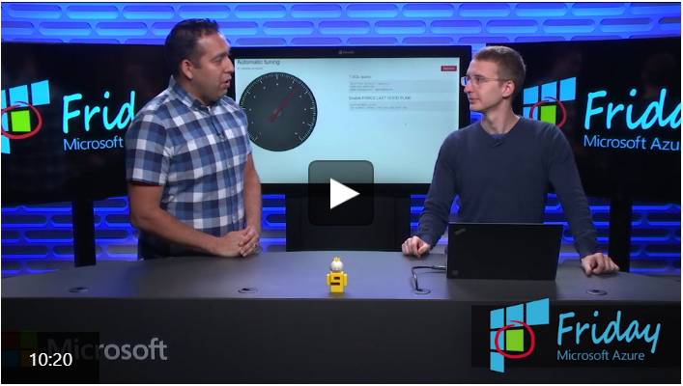
For an overview of how automatic tuning works and for typical usage scenarios, see the embedded video

Slide 41
Automatic Tuning
Azure SQL Analytics

Slide 42
What Can Intelligent Insight do For You?
Proactive monitoring
Early detection of performance degradation
Root cause analysis
Performance improvement recommendations
Scale out deployment
Positive impact to DevOps resources
Notes:
Performance monitoring tool
Does it at scale
Single pane-for all sql database, elastic pool and manage instance
Automatic troubleshooting
Problem and solution is given
Client using this solution up to 200k database

Slide 43
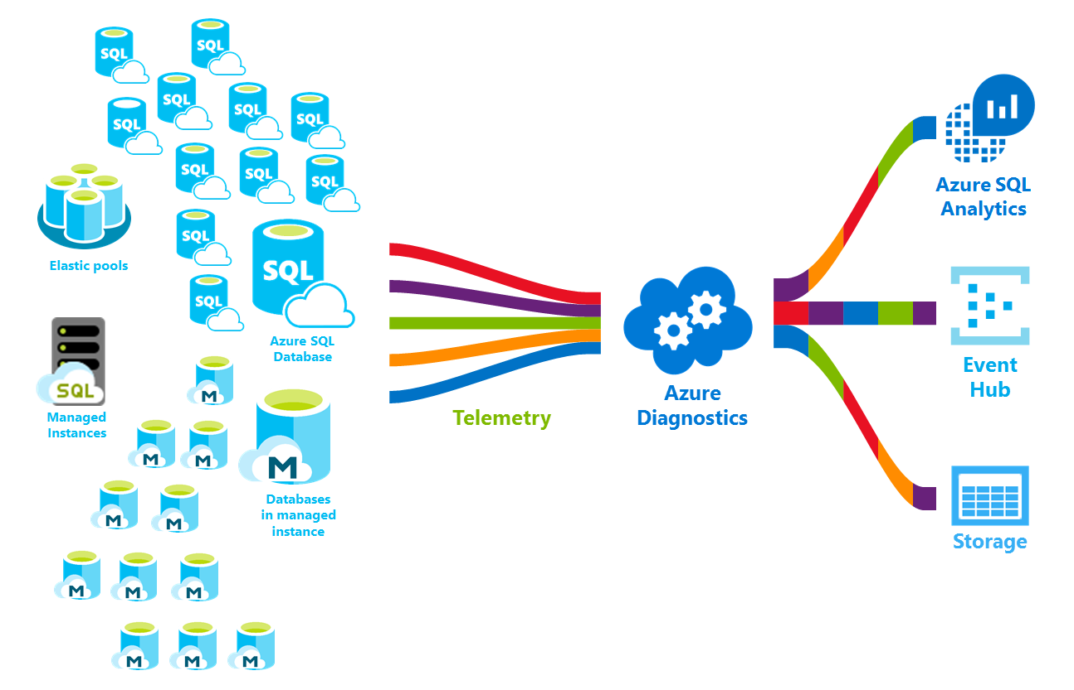

https://docs.microsoft.com/en-us/azure/sql-database/sql-database-metrics-diag-logging
Notes:
Log analytics are now part of Azure Monitor Services
Logs can be funneled to
SQL analytics
Event Hub
Blob storage

Slide 44
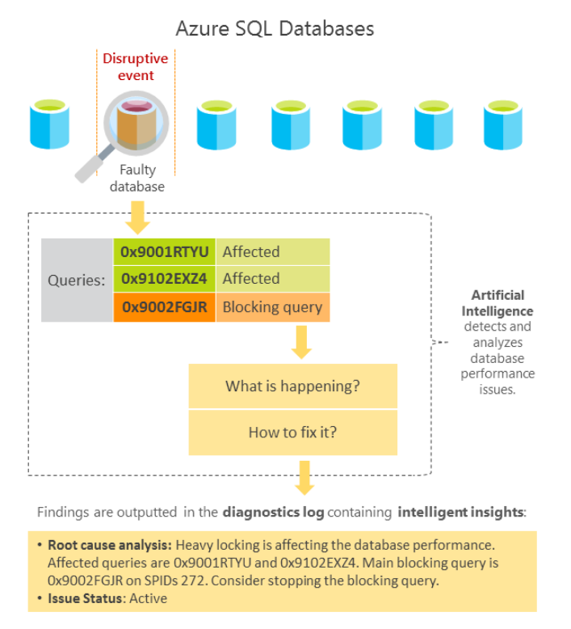
Performance issues
Query Duration
Timeout Requests
Excessive Wait Time
Errors
https://docs.microsoft.com/en-us/azure/sql-database/sql-database-intelligent-insights
Notes:
comparing database workload from last hour with past seven-day baseline workload
most repeated and largest queries
absolute operational thresholds
Metrics that caused an insight to be generated:
Query duration increase [seconds].
Excessive waiting [seconds].
Timed-out requests [percentage].
Errored-out requests [percentage].

Slide 45

Reaching Resource Limit
Memory Pressure
Pagelatch
Contention
Workload Increase
TempbDB Contention
Detectable Performance Patterns
New Query
Increased Maxdop
Locking
Increased Wait Statistics
Plan Regression

Slide 46

Notes:
Built in intelligence
Default 30 days. You can increase it but for keeping cost down you might use Azure storage for long term retention
Custom report /Query
Log analytics query language
Custom alerting

Slide 47






Notes:
Operations Management Suite (OMS) is a management offering which provides monitoring for Azure Resources through the Log Analytics service.

Slide 48





Slide 49


Slide 50

Top metric utilization per database
Notes:
We cannot cover all information. Giving few example only

Slide 51

Insights Across Enterprise (Hierarchy)

Slide 52

Insight Per Resource (Database)

Slide 53

Insight Per Resource (Database)

Slide 54


Insight Details Queries

Slide 55

Insight Details Database Waits

Slide 56

High Impact Item Details

Slide 57

Balance Elastic Pool Resource

Slide 58

Single Query Performance Across
Notes:
SAS provider
Through the Query duration and query waits perspectives, you can correlate the performance of any query through the query report. This report compares the query performance across different databases and makes it easy to pinpoint databases that perform the selected query well versus ones that are slow.
Once the Azure SQL Analytics tile for the database is selected, the monitoring dashboard is shown.
Selecting any of the tiles, opens a drill-down report into the specific perspective. Once the perspective is selected, the drill-down report is opened.

Slide 59

For a hands-on overview on using Azure SQL Analytics solution and for typical usage scenarios, see the embedded video

Slide 60
Automatic tuning
Query Performance Insights
Azure SQL Analytics
Automatically tune some of the most common database performance issues.
Basic Azure SQL Database performance monitoring needs.
Advanced monitoring of database performance at scale, with built-in intelligence.

Slide 61
Automatic Tuning
Azure SQL Analytics

Slide 62
dm_db_resource_stats
resource_stats
Returns cpu, IO, memory
Same data rolled over every 5 minutes
Collects every 15 sec
Retains for an hour
Retained for 14 days

Slide 63


Slide 64


Slide 65
Resource
Azure SQL Database - Monitoring and tuning
Azure Monitor pricing
Performance recommendations for SQL Database
Query Performance Insight for Azure SQL Database
Troubleshoot Azure SQL Database performance issues with Intelligent Insights
Intelligent Insights using AI to monitor and troubleshoot database performance
Monitor Azure SQL Database using Azure SQL Analytics (Preview)
Use Case - Artificial Intelligence tunes Azure SQL Databases
Log Analytics FAQ

Slide 66
Work
Outside Work
Giving Back
Running—One 26.2 and Many 13.1
Frequent speaker local user groups, SQL Saturdays & Virtual groups
Blog at sqlworldwide.com
13 years as DBA
10 years in Merchant Marine
MCSE Data Management and Analytics
Answering questions at #sqlhelp & dba.stackexchange
Shuttling 3 kids
Co-organizer NESQL User Group

Slide 67





@SqlWorldWide
linkedin.com/in/taiobali
sqlworldwide.com
taiob@sqlworldwide.com

Slide 68


